Slide 1

Crime in the UK Final presentation
Week 12 - 01.02.2017
Sergiu Soima
Chaoran Chen
Aser Abdelrahman
Notes:
Criminality is a phenomena that accompanied mankind throughout history since its beginning. Even in our today’s organized societies that present the product of an evolutionary process over many ages, crimes diversity, extent, and types still vary with respect to the different cultures.

Slide 2

Sir Bernard Hogan-Howe former head of London’s Metropolitan as Commissioner of Police of the Metropolis (MPS)
“I came into this job determined to fight crime...It's the most rewarding of jobs to protect good people and lock up the bad guys.”
Notes:
We have the same goal as Sir Hogan-Howe, that is to contribute to the prevention of crimes. With our datamining approach, we want to understand the criminal behavior in the UK and thus use predictive alorithms to protect good people.

Slide 3






Agenda
1. Datasets presentation
2. Data preparation
3. Problems with the data
4. Descriptive Statistics
5. Predictive datamining
6. Used Methods and Technologies
Notes:
This is our plan for the next 20 mins. First we will present the basis of our project, the datasets, how we prepared them and which problems we faced.
Afterwards, in the descriptive part we will focus on 4 main questions.
Based on the answers, we will present the prediction algorithms we have developed
Last but not least we will give you an overview about the methods and technologies we used through out the lab course.

Slide 4
1. Datasets presentation

Slide 5
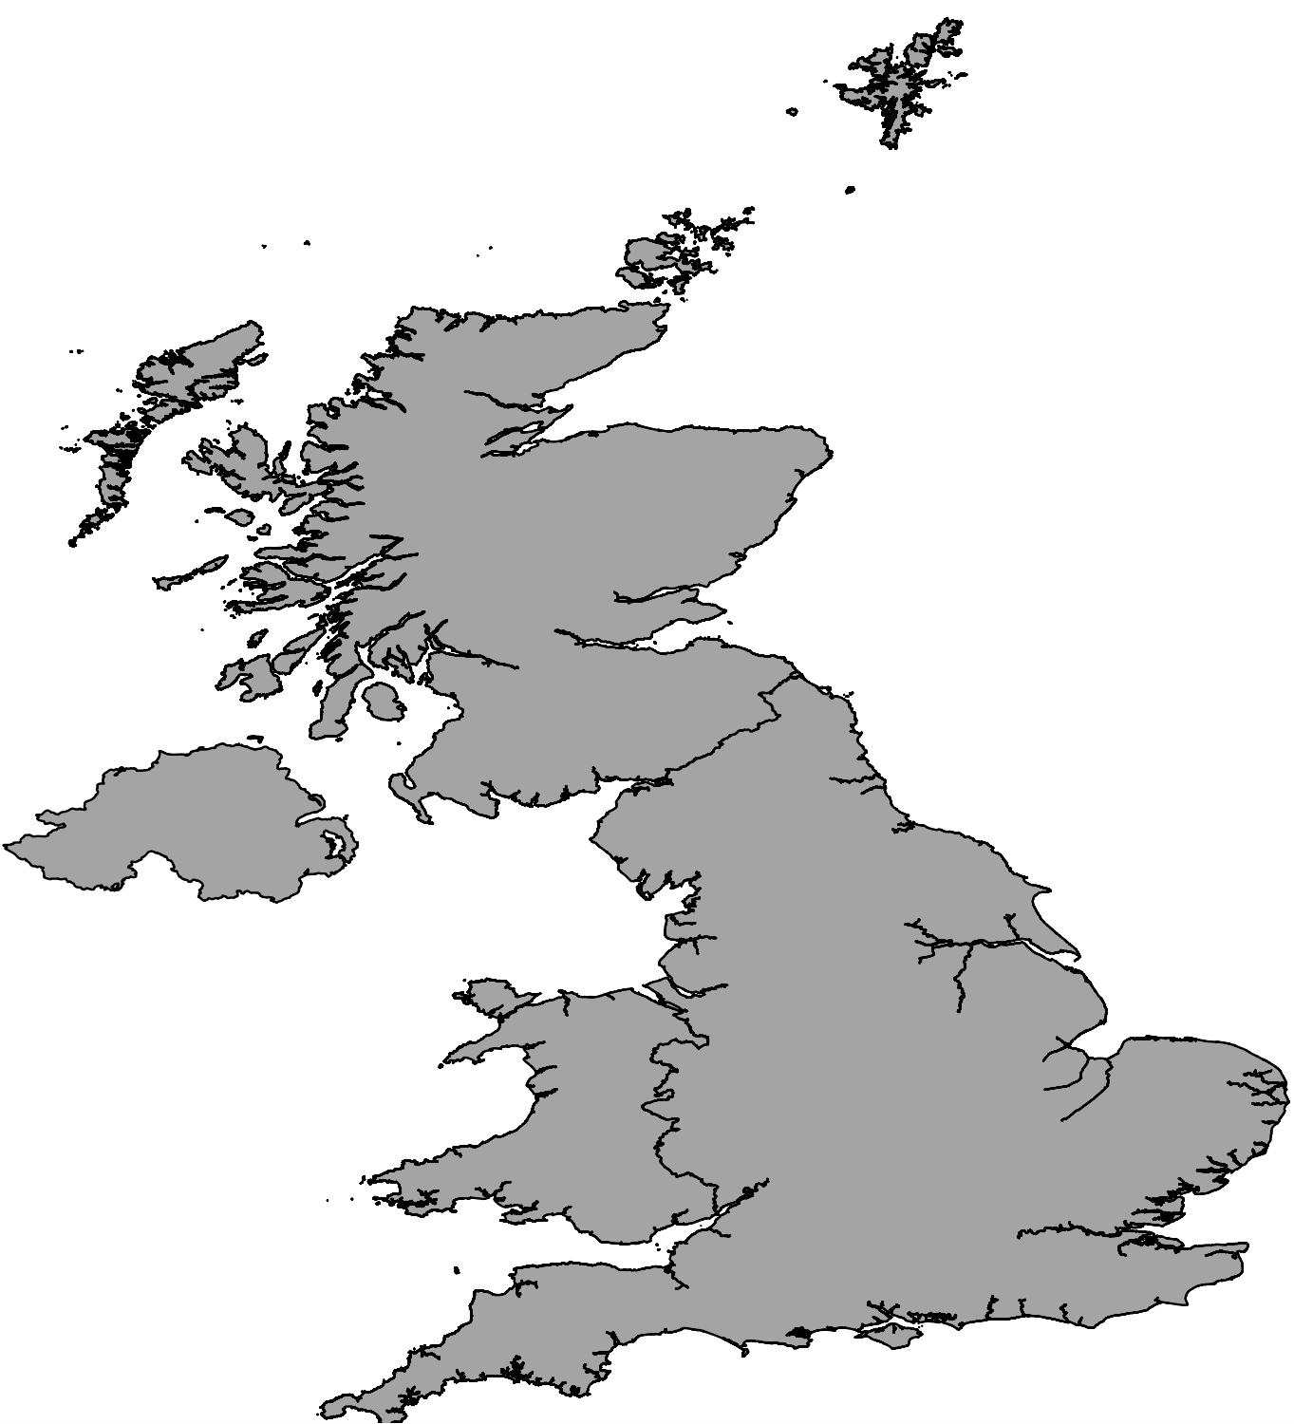
Notes:
First we started with a blank map of the UK. As you can see it consist of 4 main regions: ….
There are a lot of ways to divide the UK into areas. During the lab, we’ve worked with many different types such as the Postcode areas, Local Authority Areas and Super Output Areas. They all have some advantages and disadvantages. In this presentation, we will only focus on the Super Output Areas.

Slide 6
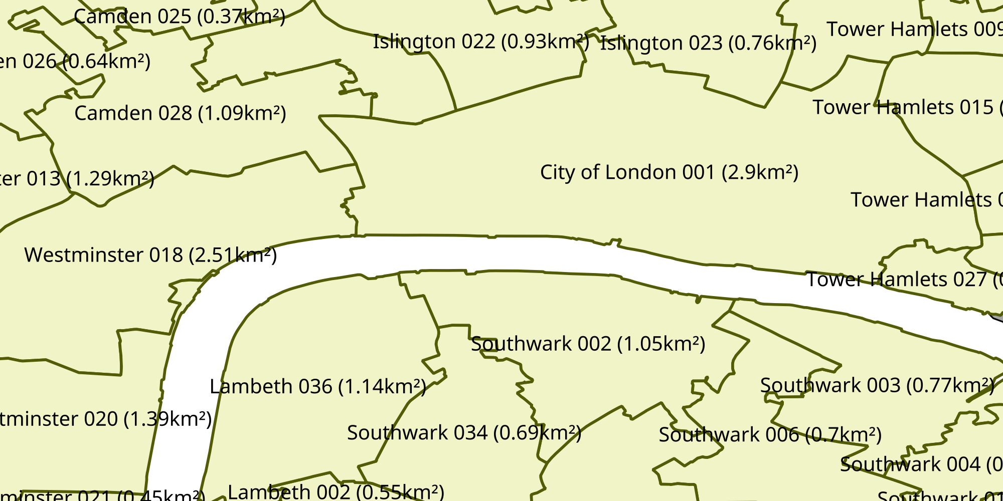
Middle Super Output Area (MSOA)
From census 2011
Population of ≈7,200
≈7,000 areas
Demographic data: selected 150 features out of 130,000
Notes:
There are two types of them. The MSOA, ….
They are small areas with an average size of 21 km² and were defined for the census 2011. [Alles, was in der Box steht]

Slide 7
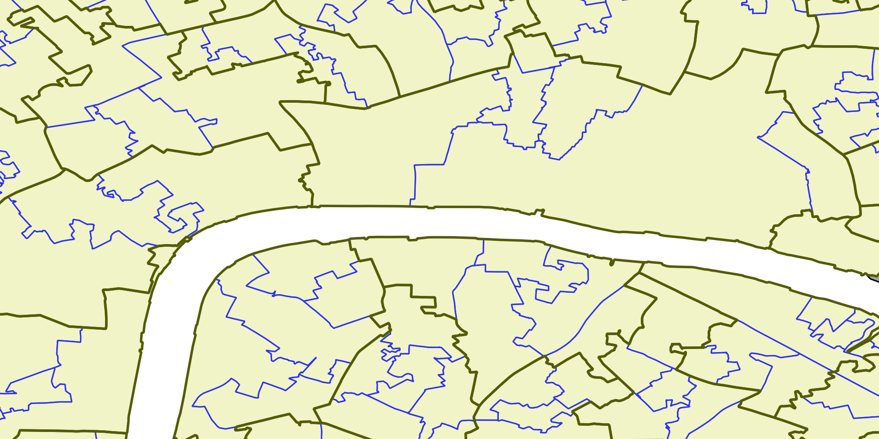
Lower Super Output Area (LSOA)
Population of ≈1,500
≈35,000 areas
Notes:
MSOAs can be divided into LSOAs. They have an average size of only 4 km² and an average population of 1,500.

Slide 8
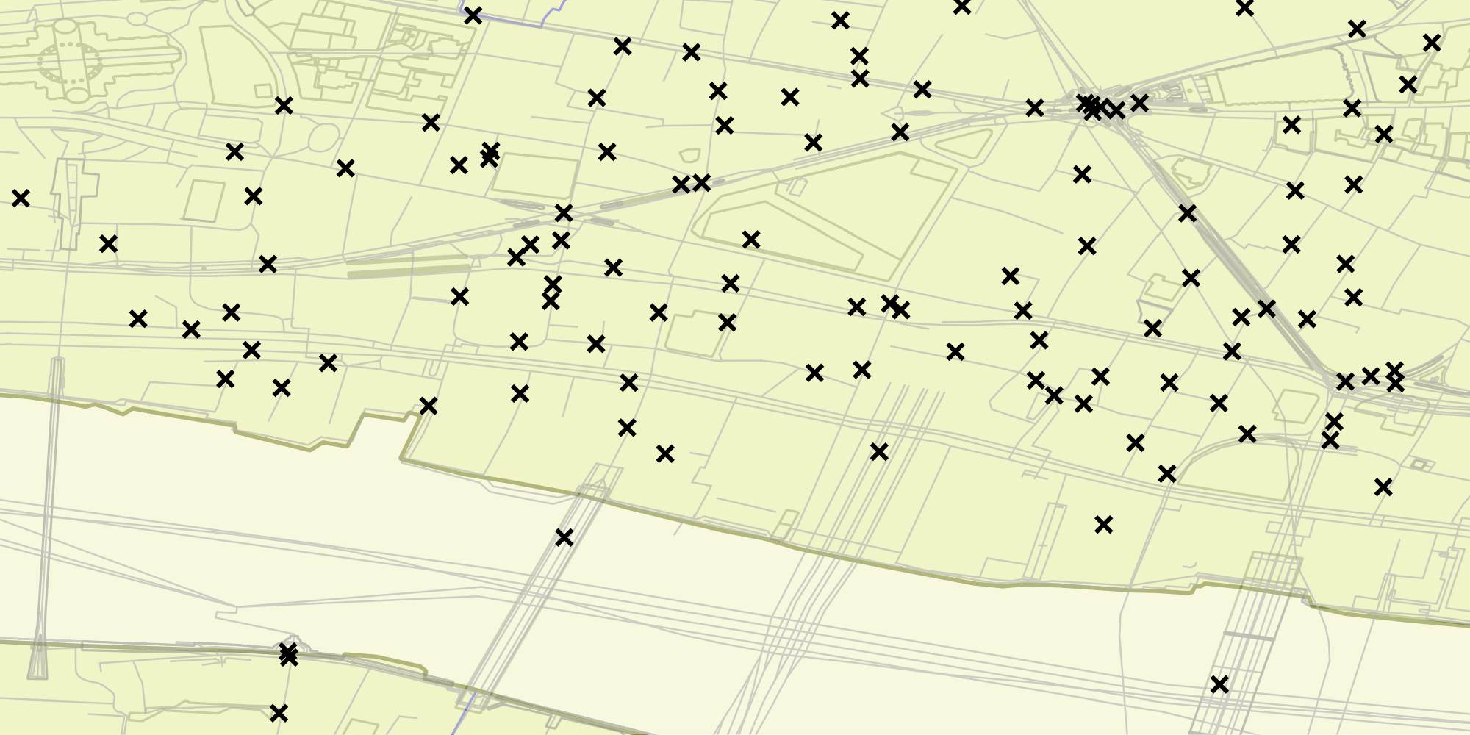
Crimes
12.2010 – 08.2016
Attributes:
Crime type
Date (year and month)
Location
Outcome
Information about victim
Information about perpetrator

Slide 9
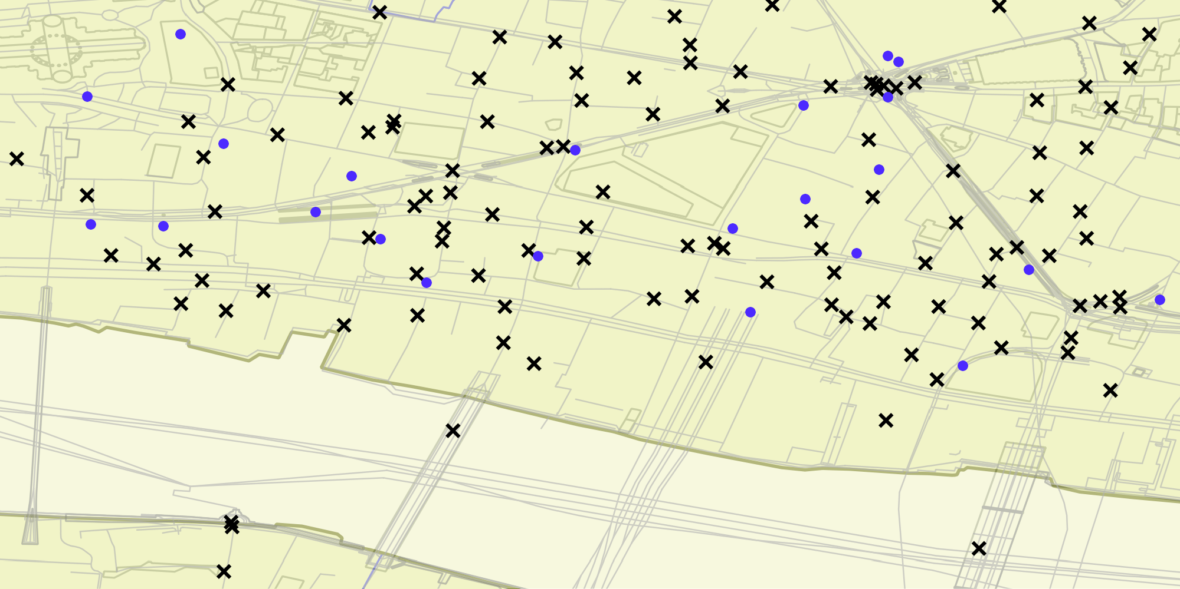
Stop and Searches
12.2014 – 08.2016
Attributes:
Date (year, month and day)
Location
Gender
Age
Ethnicity

Slide 10
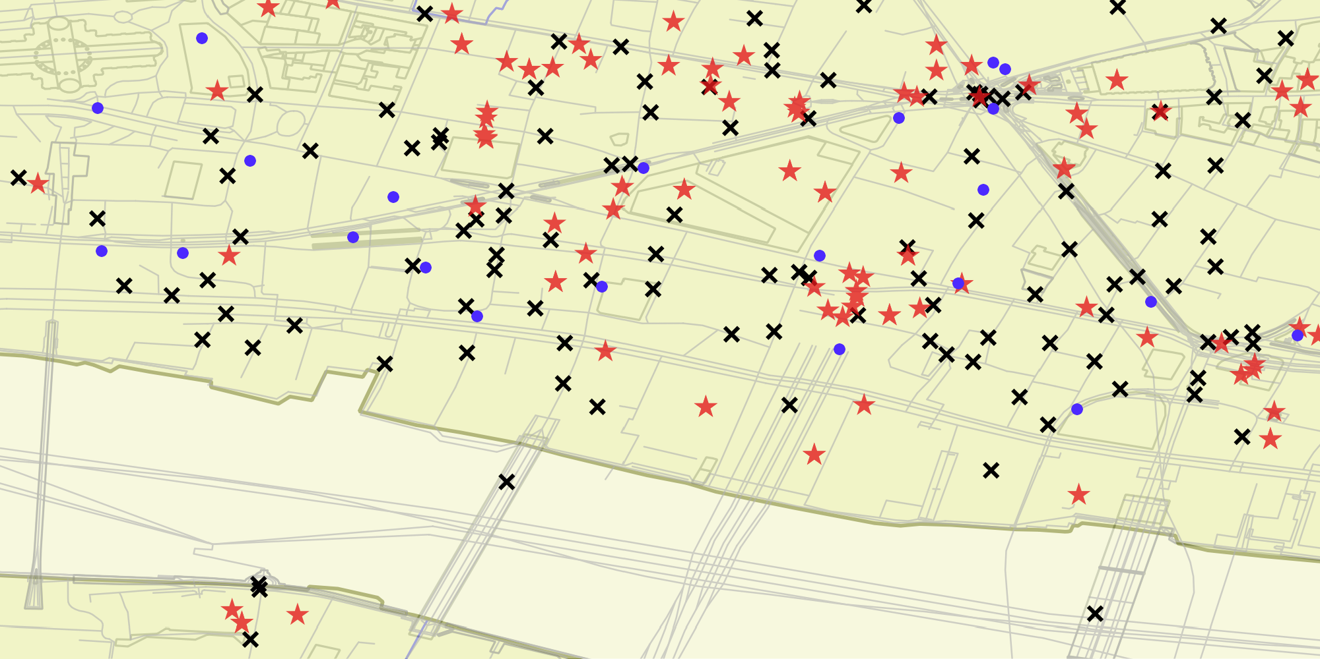
Points of Interest (POI)

Slide 11
Data Sets
Data set | Size | Source
Crimes | 13GB / 30 Mil. tuples | data.uk.com (merged from 2 data sets)
Stop and Search | 120 MB / 560,000 tuples | data.uk.com
Points of Interest | 20 MB / 190,000 tuples | PocketGPSWorld.com
Demographics | 5.5 GB (before feature selection) | Census 2011

Slide 12
3. Problems with the data
2. Data preparation
Notes:
The quality of the data, which we got from the Police UK, are quite good. On their website, they have described several processes, that should ensure the quality.
But still.. they are not perfect.

Slide 13
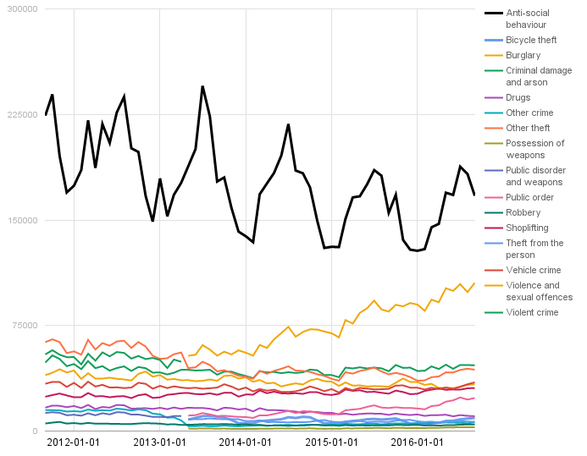
General Data Preparation
Crime Type
Created “Crimes” from “Streets” and “Outcomes”
Feature selection for Demographics
Merged crime types

Slide 14
General Data Preparation
Created “Crimes” from “Streets” and “Outcomes”
Feature selection for Demographics
Merged crime types
Removed old data

Slide 15
General Data Preparation
Location Field
Created “Crimes” from “Streets” and “Outcomes”
Feature selection for Demographics
Merged crime types
Removed old data
Unified location names
“On or near Moretons Lane”
vs.
“On or near Moreton'S Lane”

Slide 16
3. Problems with the data

Slide 17

Problems with the Data Set
Large data set ➔ hard to process
MySQL → PostgreSQL → MonetDB
Write efficient SQL-Queries: use window functions
Do not use Pandas
Get a powerful server: Azure Service

Slide 18
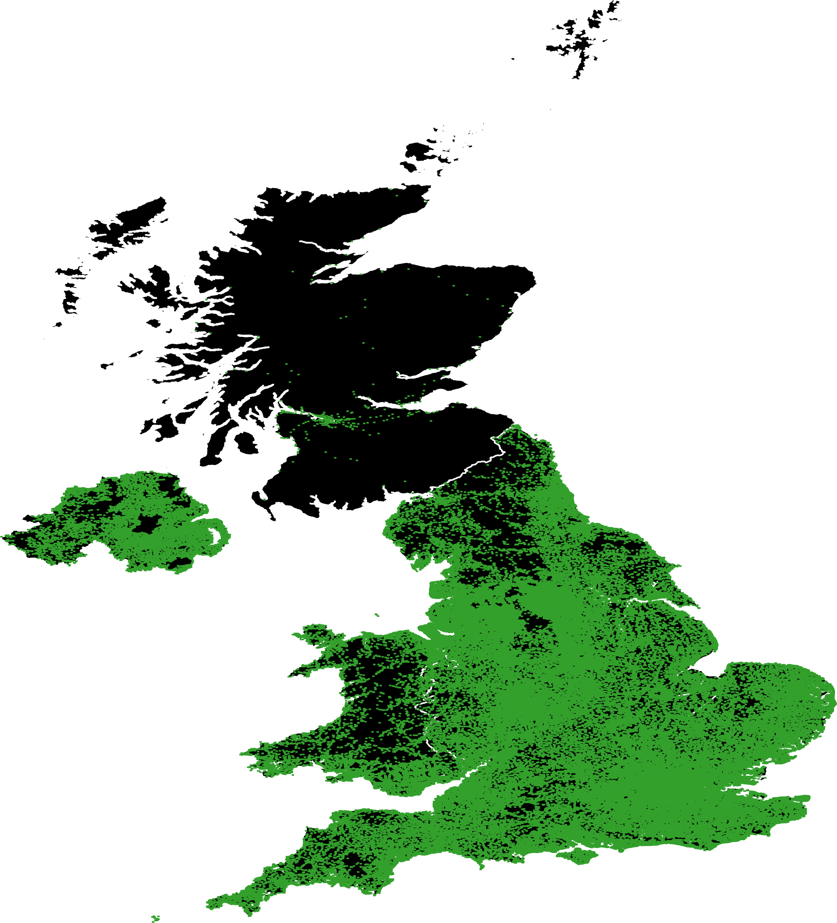
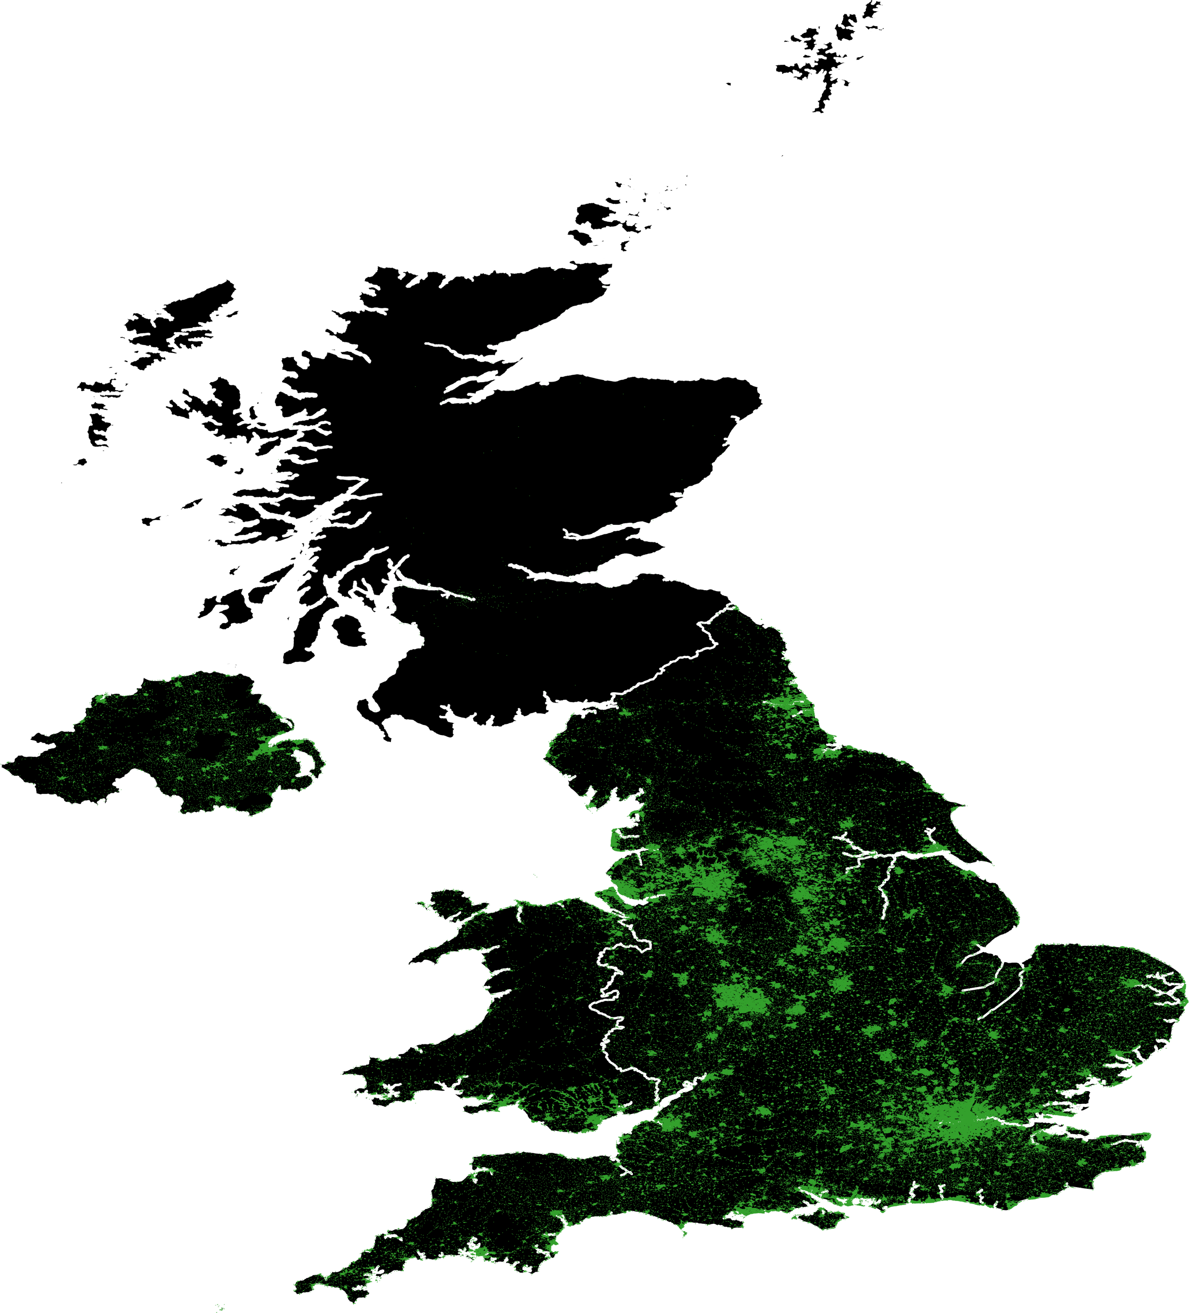
Problems with the Data Set
Dark Map
1 km radius
200 m radius
Large data set ➔ hard to process
MySQL → PostgreSQL → MonetDB
Write efficient SQL-Queries: use window functions
Do not use Pandas
Get a powerful server: Azure Service
Anonymized coordinates: location accuracy
„If the nearest map point is more than 20km away, the co-ordinates are zeroed out.“
– UK Police

Slide 19

4.Descriptive datamining

Slide 20
When do crimes happen?

Slide 21
When do crimes happen?

Slide 22
When do crimes happen?

Slide 23
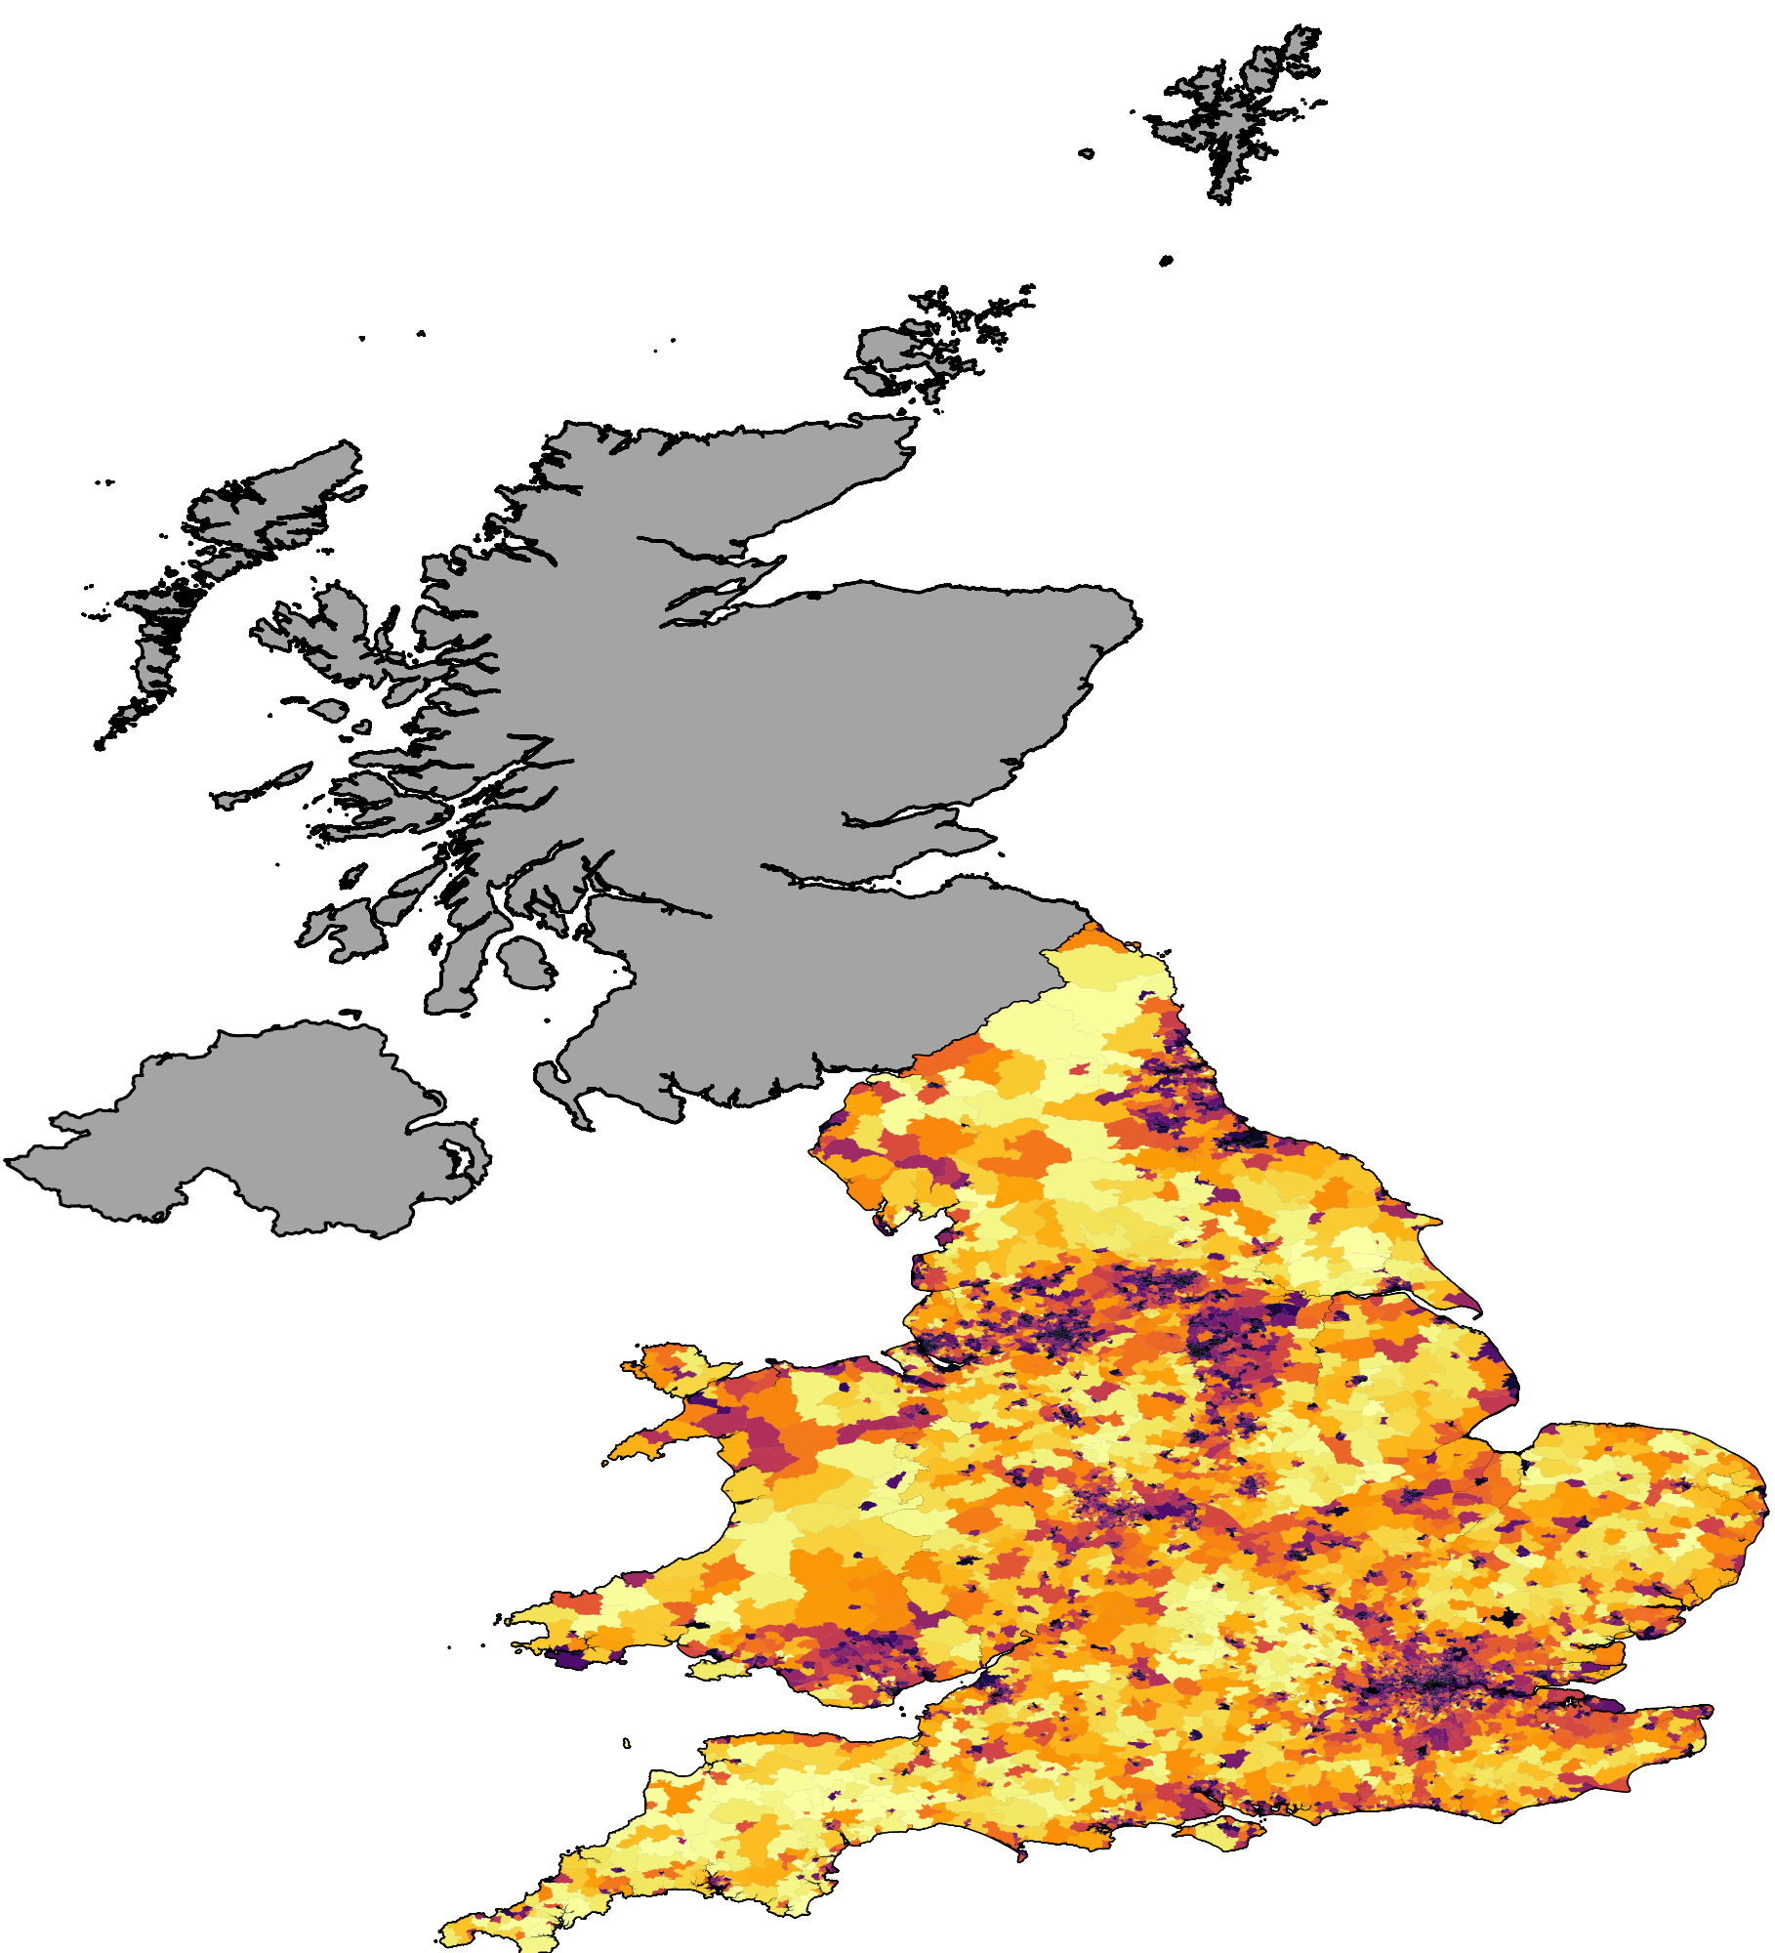
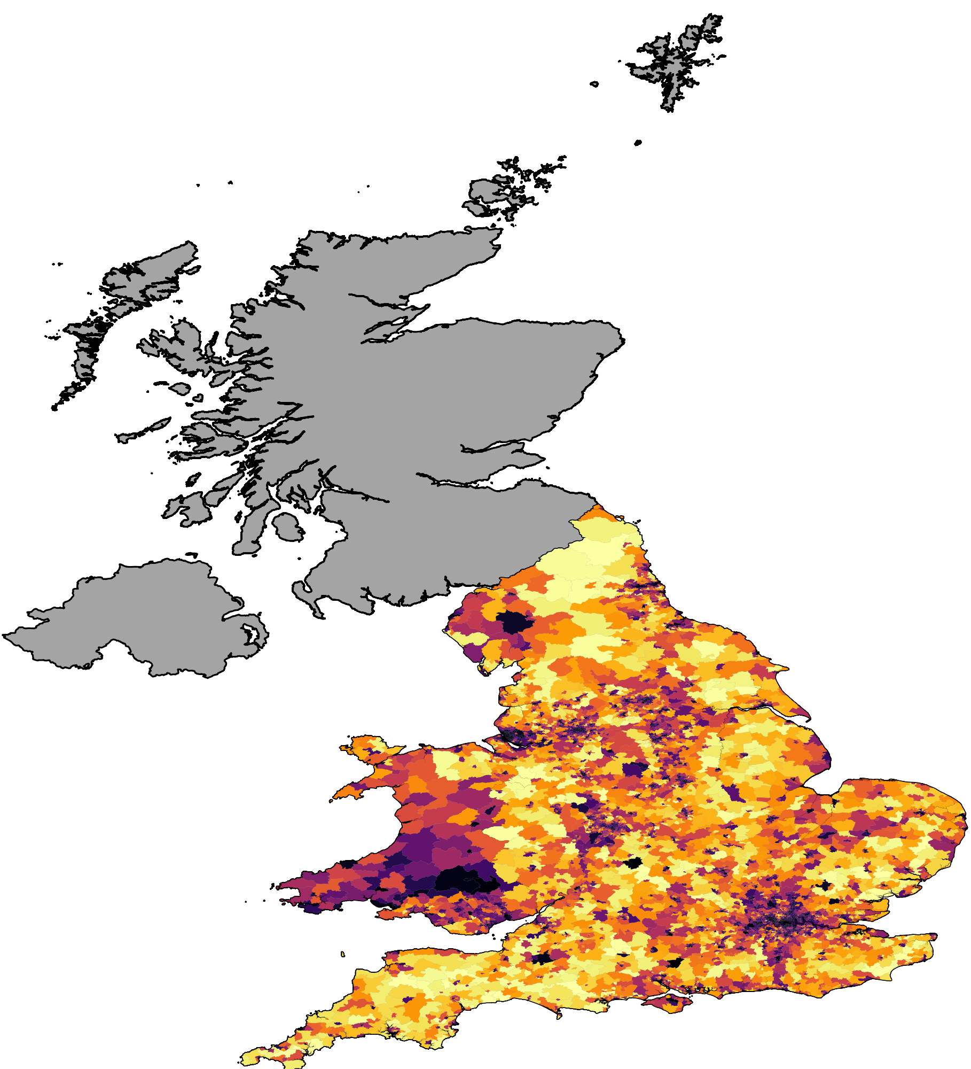
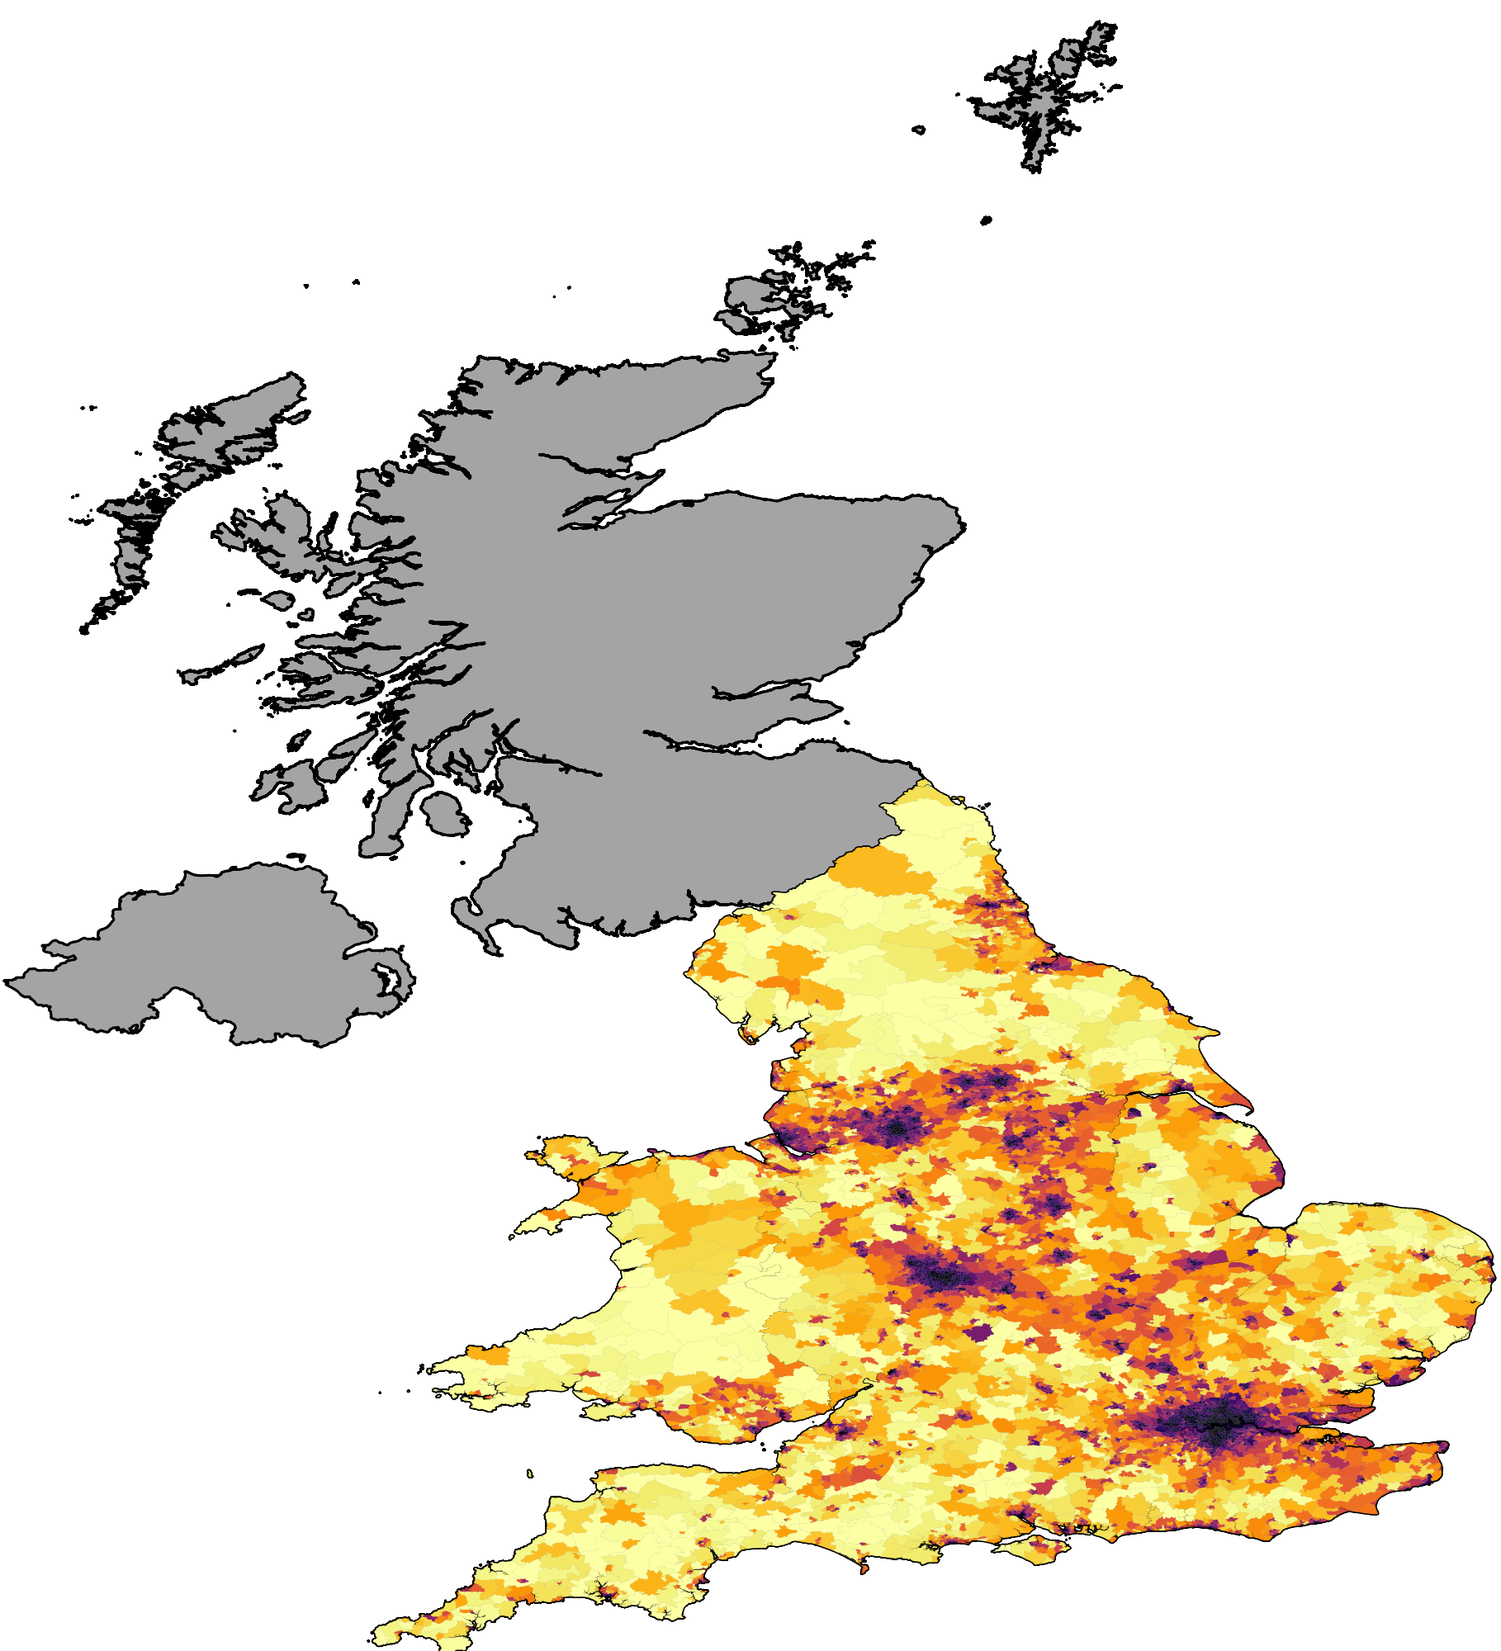
Where do crimes happen?
All crimes
Crime type: drugs
Crime type: robbery

Slide 24
Crimes and Punishment – what’s up with the ending?
Notes:
slide nochmal machen

Slide 25
Crimes and Punishment – what’s up with the ending?
Notes:
slide nochmal machen

Slide 26
Descriptive statistics
Police stop and searches statistics

Slide 27
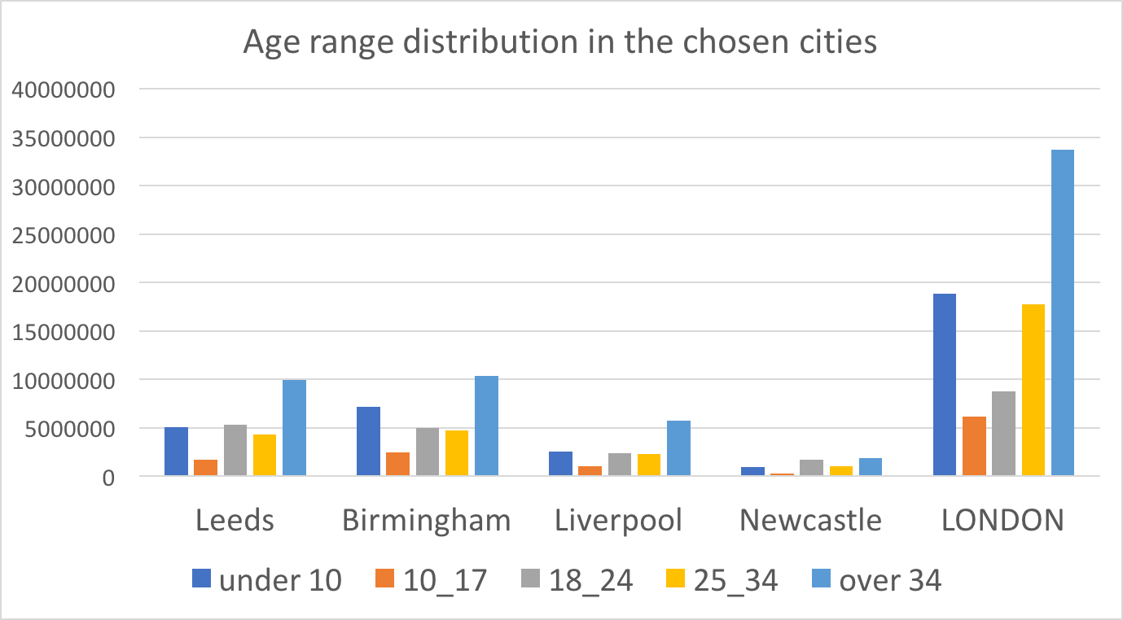
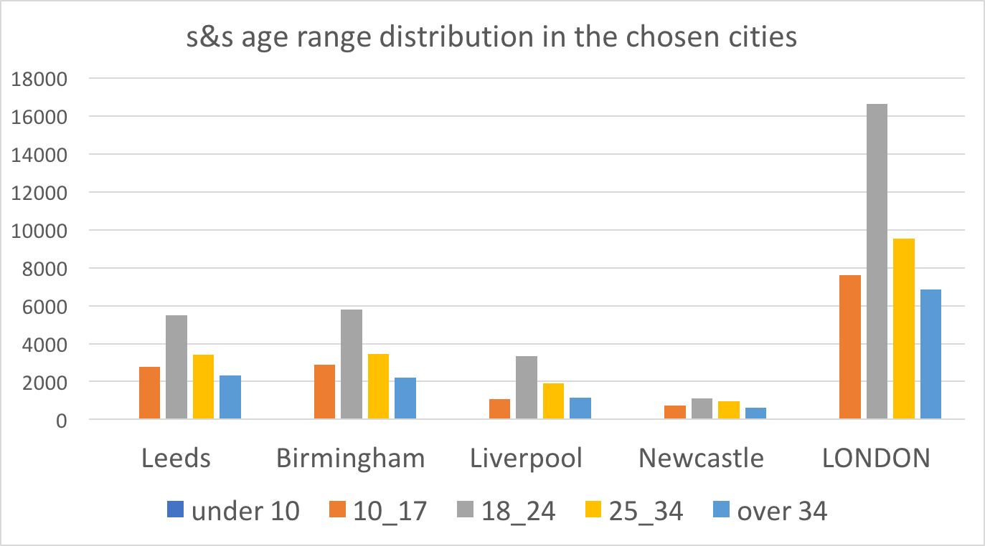
In which age ranges are people stopped more often?

Slide 28
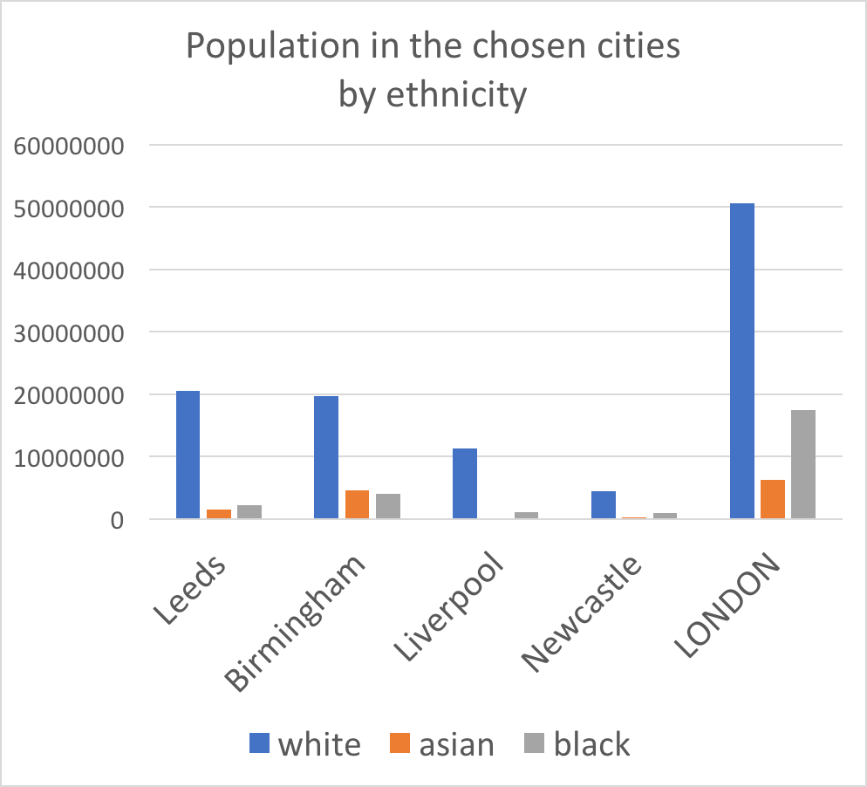
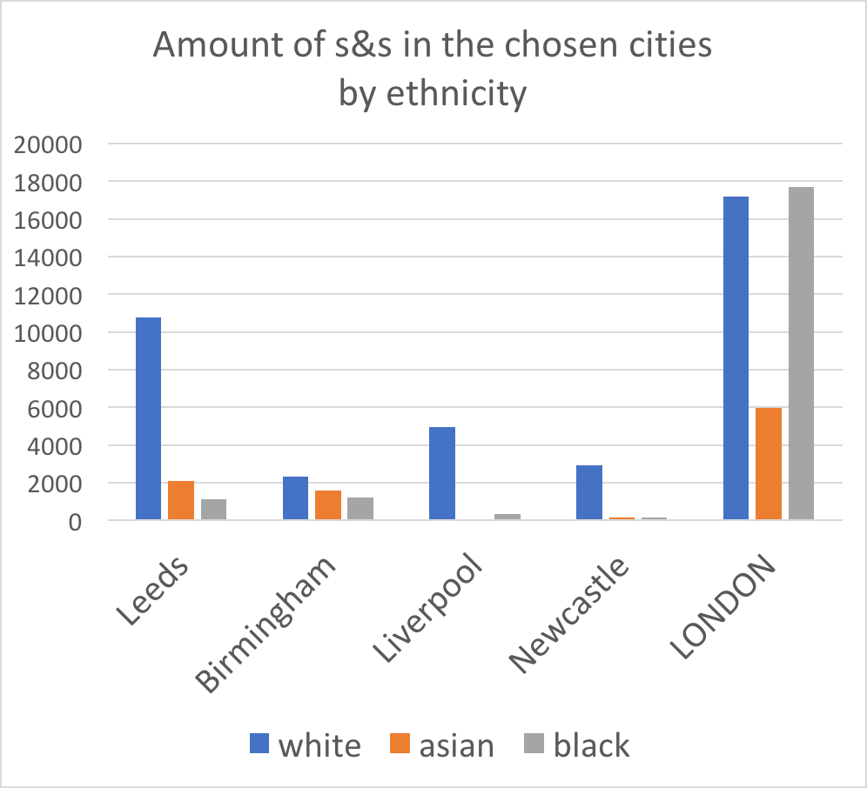
Which ethnicity is more likely to be stopped?

Slide 29
Men are 9 times more likely to be stopped

Slide 30
5. Predictive datamining

Slide 31
Predictive datamining:
Predict crime outcome types in the city of London
Predict the effects of demographic structure on criminal behavior
Detect anomalous areas with respect to criminal behavior based on demographic structure

Slide 32
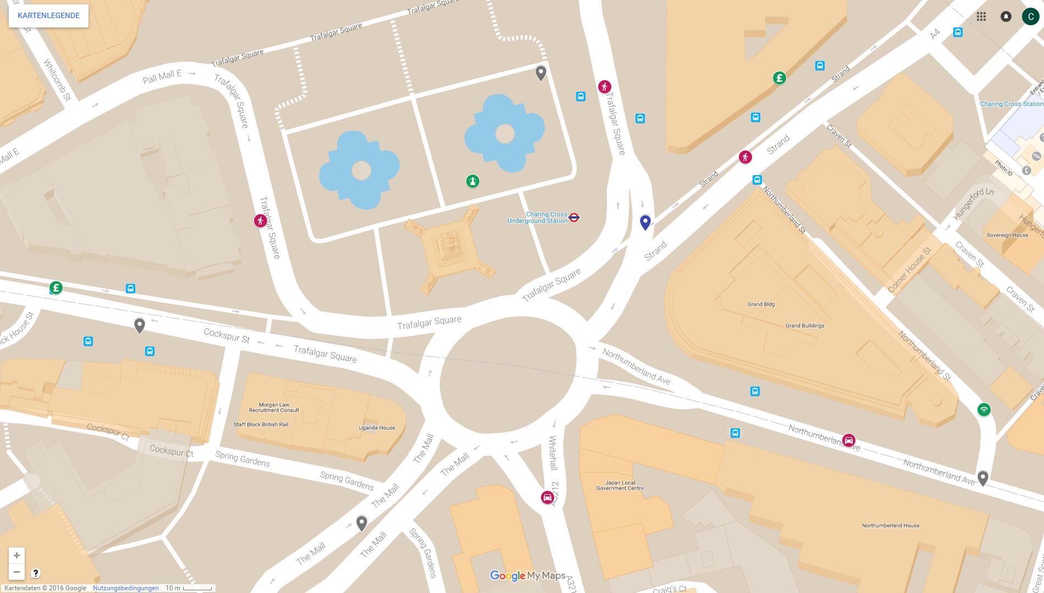
Crime 6123122792
Crime type: Theft from the person
Outcome: Defendant found not guilty
Date: September 2016
Police force: City of London
Latitude / Longitude
Lower Layer Super Output Area (LSOA)
---------------------------------------------
Number person searches: 2
Number vehicle searches: 0
Number fountains: 1
Number banks 1
Number Wi-Fi hotspots: 0
500 m

Slide 33
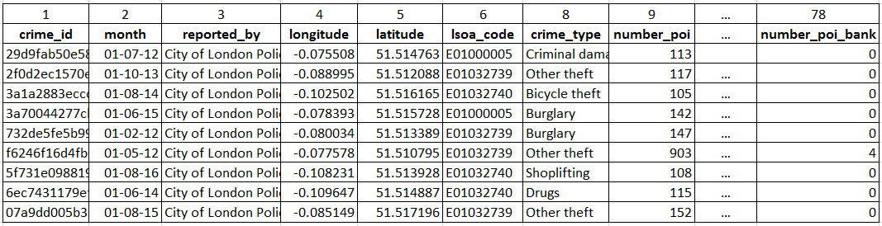
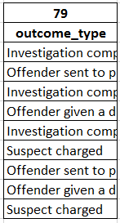
1. First Approach for Predicting Crime Outcome Types
?

Slide 34
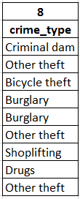
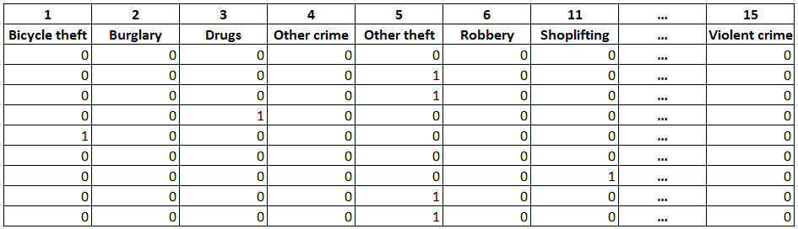
First Approach for Predicting Crime Outcome Types
Data preprocessing:

Slide 35
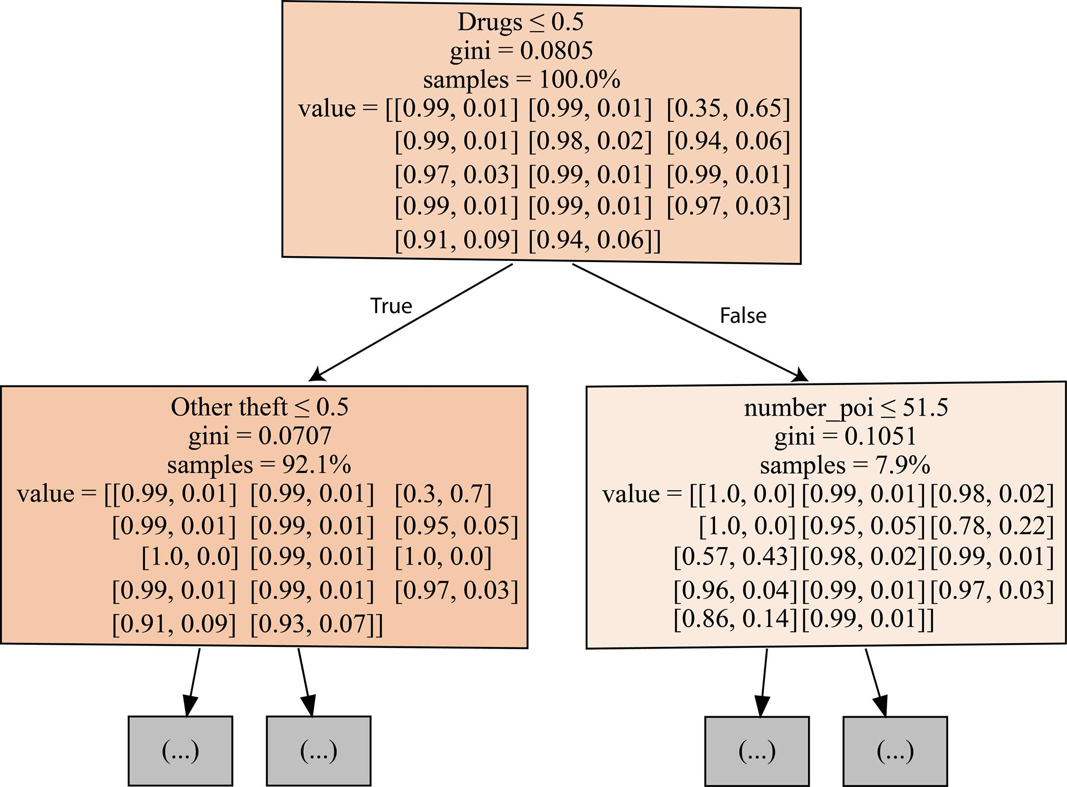
First Approach for Predicting Crime Outcome Types
10 decision trees in the forest
cross validation score: 54.8%
Accuracy of test data: 55.2%
Weighted F1-score: 0.544
Notes:
We believe we don’t have the sufficient features for getting better results: E.g information about the victims(s) and criminal(s)

Slide 36
Predicting Number of Crimes
Demographic Data
Population, #males/females
Age distribution
Ethnicity group
Religion
…
Points of Interest
Total number
Number of supermarkets
…
Number of crimes
Total number
Of a certain crime type
Notes:
- the prediction of the number of crimes in a certain area given the demographic data and the number of points of interest.

Slide 37
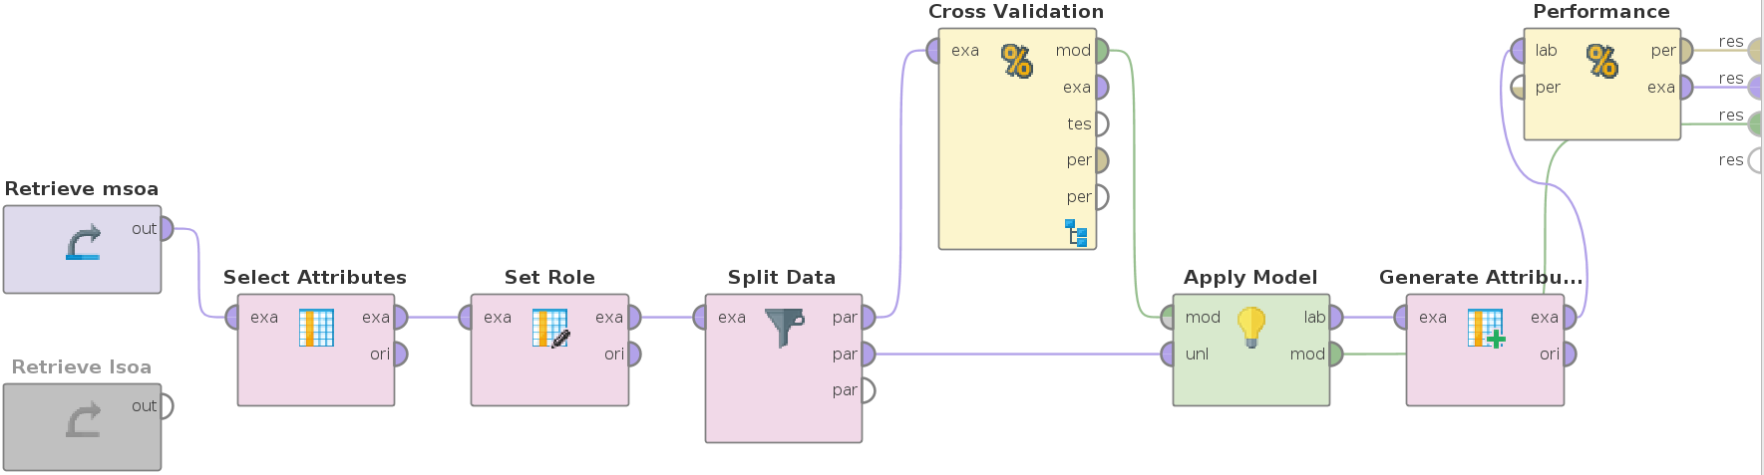
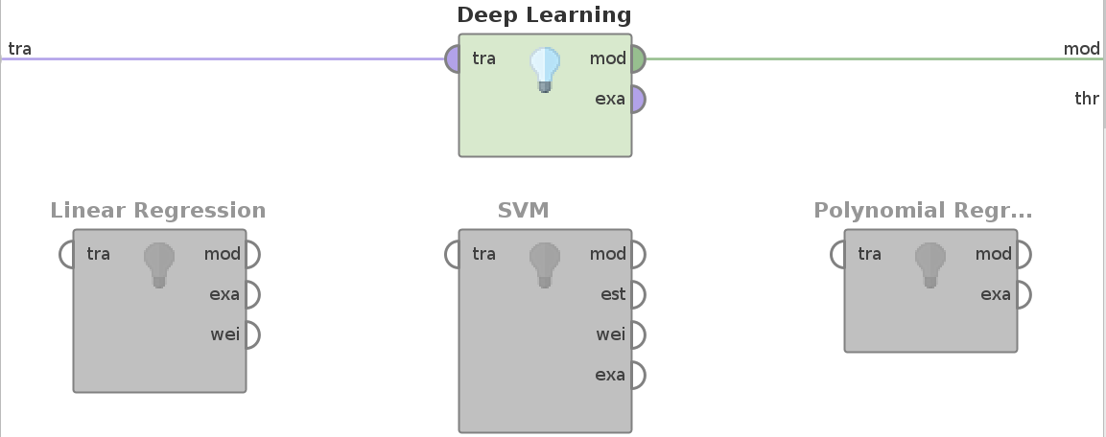
Predicting Number of Crimes
Notes:
RapidMiner with different settings
MSOA 20km², LSOA 4km²
explicitly computed the relative squared error for every tuple in the test set
At the end, we found that the MSOAs and Deep Learning (with 3 hidden layers) give the best result. After running it, we have tried to find reasons and patterns for mispredictions.

Slide 38
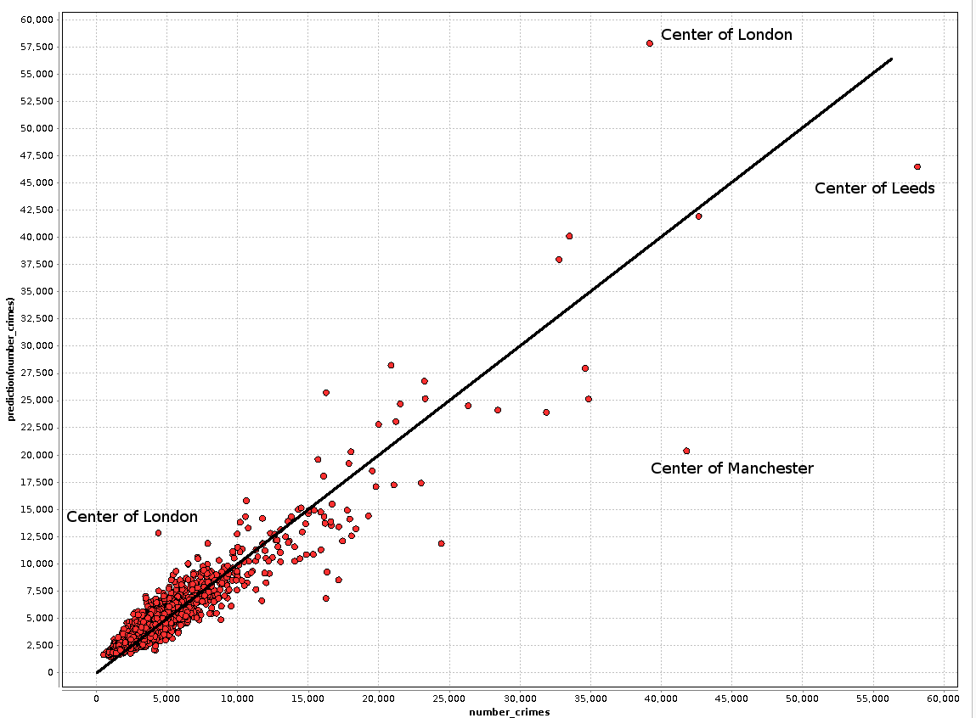
Predicting Number of Crimes
Root mean − squared error: 1424
Root relative - squared error: 37.3%
Correlation: 93.5%
Predicted Total Number of Crimes
Average number of crimes: ≈4,000
Actual Total Number of Crimes

Slide 39
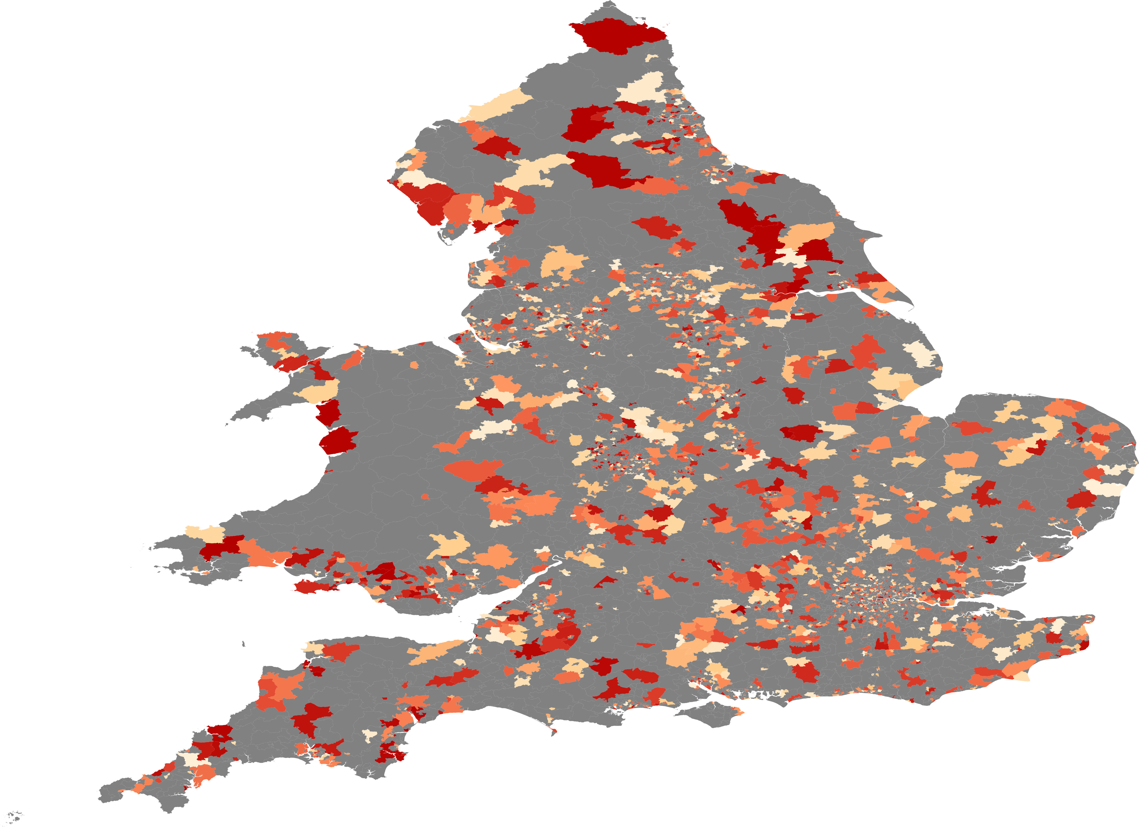
Predicting Number of Crimes
Notes:
One approach was to visualize the mispredictions on a map. So here the grey areas were used for the training and the remaining areas for testing, and as redder an area is as larger was the mispredictions. But unfortunately, there seems to be no pattern.

Slide 40
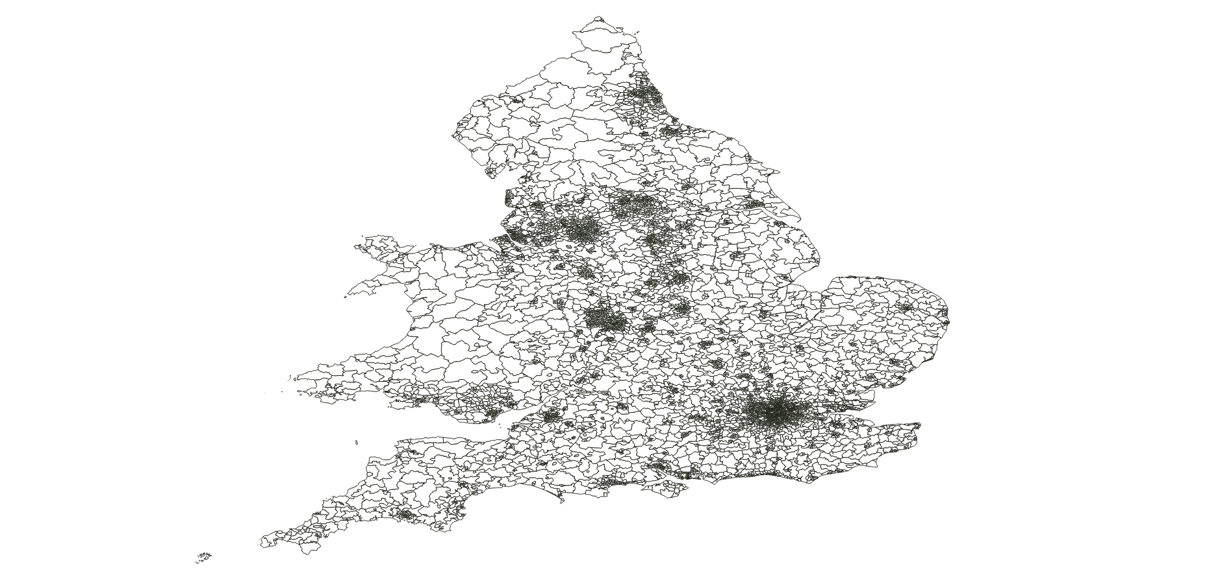
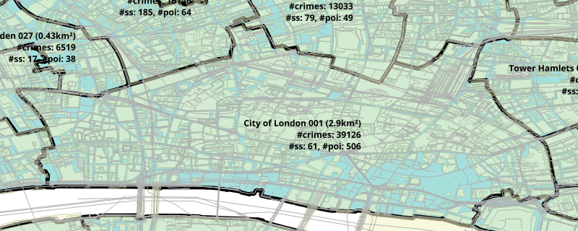

3. Outlier detection
?
=

Slide 41
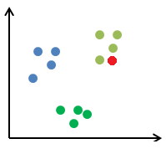
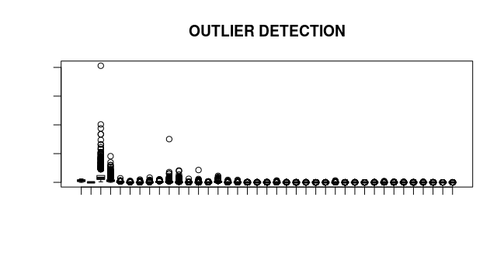
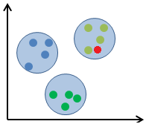
In which respect are those 673 MSAOs abnormal?
1. Start only with demographic data
2. Form cluster
3. What factors define an “outlier”?
Cluster 2
Cluster 1
Number of Crimes
Outlier wrt. criminal behavior
Cluster 3
Crime Features

Slide 42
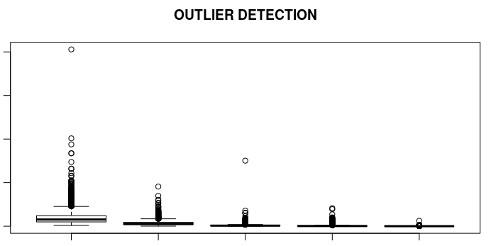
In which respect are those 673 MSAOs abnormal?
80k
60k
Number crimes
40k
20k
0
Total crime types
Number Anti-Social
Number other theft
Number Shoplifting
Number Robbery
Notes:
Größer!!!

Slide 43
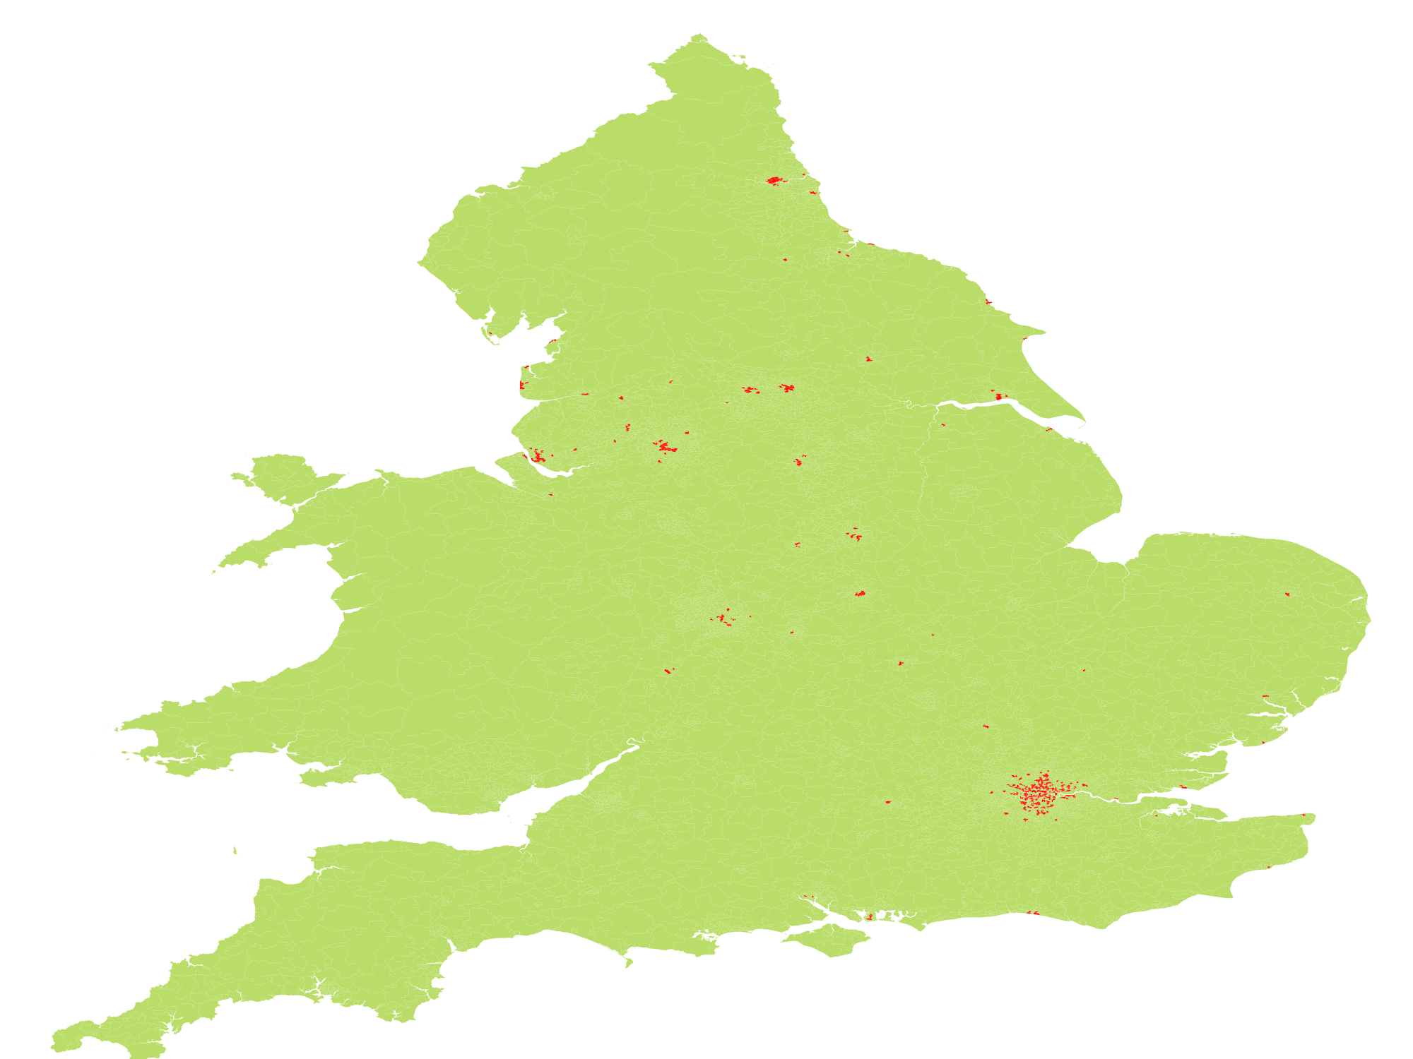
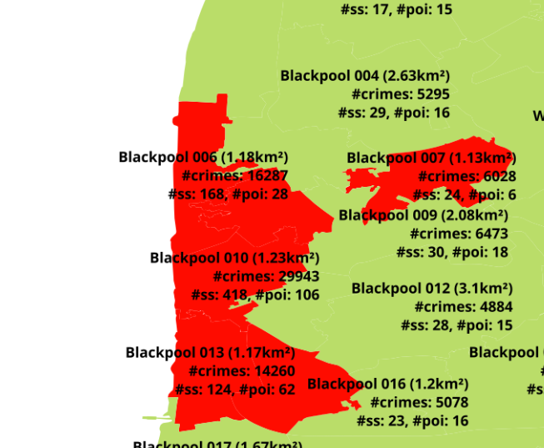
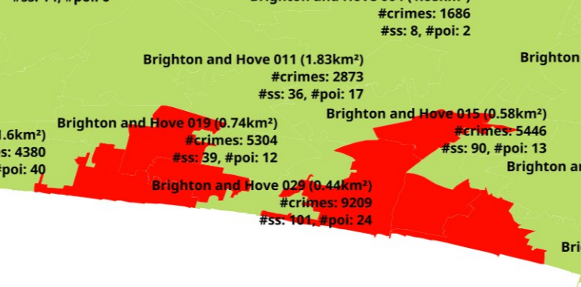
Leeds
Hull
London
Notes:
→ Noch reinzoomen in den Bildern

Slide 44
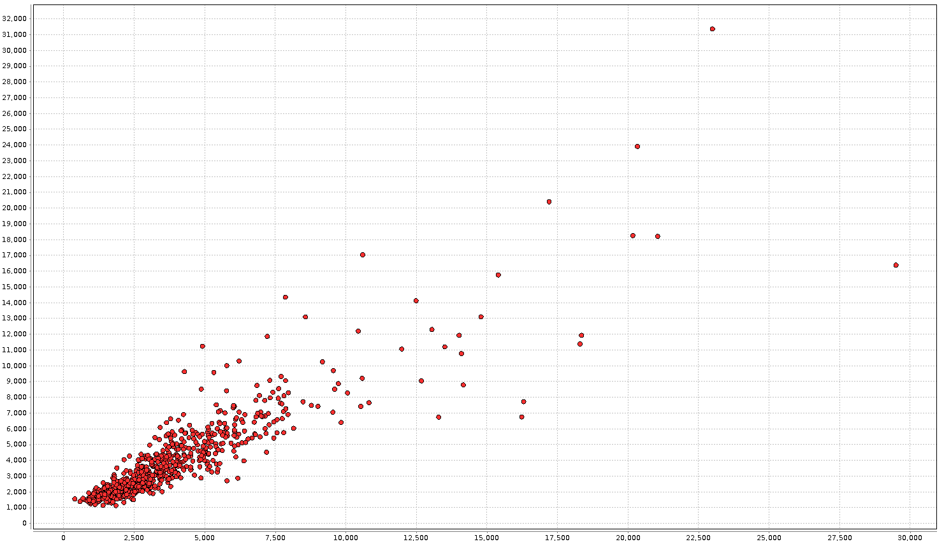
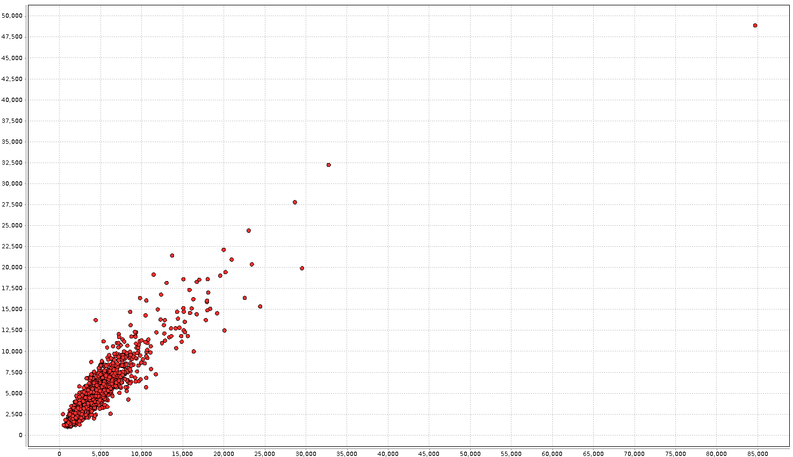
Regression revisted – 1st Cluster
1. With outliers:
2. Without outliers:
Predicted Total Number of Crimes
Predicted Total Number of Crimes
Actual Total Number of Crimes
Actual Total Number of Crimes
Root mean − squared error: 1472
Root relative - squared error: 42.7%
Correlation: 91.6%
Root mean − squared error: 1393
Root relative - squared error: 46%
Correlation: 89%

Slide 45


Slide 46













